Slide 1
Chapter 9: IoT Applications in Business
IOT CƠ BẢN
502068

Slide 2
Ghi chú về bản quyền
Toàn bộ nội dung bài giảng là của CISCO, sinh viên có quyền tải về, lưu trữ, in ấn, tham khảo cho mục đích học tập. Sinh viên không được phát hành lại hay thay đổi nội dung slide nếu chưa có sự đồng ý của chủ sở hữu.
Phần ghi chú ở cuối slide (nếu có) là do các thầy cô ghi chú lại trong quá trình giảng dạy.

Slide 3
Chapter 5: IoT Applications in Business
IoT Fundamentals
Connecting Things v2.01
Notes:
Cisco Networking Academy Program
Connecting Things
Chapter 5: IoT Applications in Business

Slide 4
Chapter 5 - Sections & Objectives
5.1 The Cisco IoT System
Explain how Cisco equipment, software, and services enable IoT systems.
5.2 Industrial IoT Applications
Explain the value of Industrial IoT Applications.
5.3 IoT Systems in the Real World
Explain how IoT systems solve real world problems.
Notes:
3

Slide 5
5.1 The Cisco IoT System

Slide 6
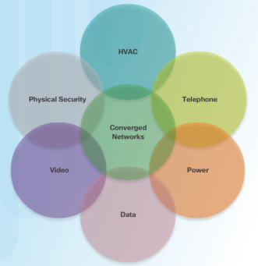
The Cisco IoT System Cisco IoT System Overview
Connecting Things
Allows for things to be accessible over the Internet that historically have not been.
Home appliances, cars, sensors, and more.
Industrial applications require a higher degree of reliability
The Converged Network and Things
Many things are currently connected using a loose collection of independent networks.
Independent networks are harder to incorporate into the IoT.
Networks that would benefit from convergence: cars and residential and office buildings (heating, ventilation, air conditioning (HVAC), telephone service, security, and lighting).
A converged network is a powerful network that includes comprehensive security, analytics, and management capabilities.
Notes:
5.1 – The Cisco IoT System
5.1.1 – Cisco IoT System Overview

Slide 7
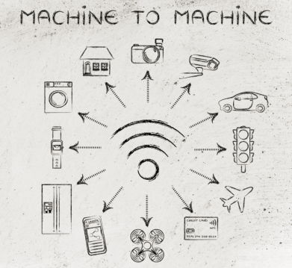
The Cisco IoT System Cisco IoT System Overview (cont’d)
Connecting and Digitizing Industry
M2M enables communication between machines.
M2M occurs in cars with temperature and oil sensors communicating with an onboard computer.
Challenges to Connecting Things
How to integrate millions of things from different vendors?
How to integrate new things into the existing network infrastructure?
How to secure these new devices, each configured with varying levels of security?
Notes:
5.1 – The Cisco IoT System
5.1.1 – Cisco IoT System Overview

Slide 8
The Cisco IoT System Cisco IoT System Overview (Cont.)
The Six Pillars of the Cisco IoT System
Uses a set of new and existing products and technologies to reduce the complexity of digitization.
Network Connectivity, Fog Computing, Security, Data Analytics, Management and Automation, Application Enablement Platform.
Supporting the IoT in Industry
Network connectivity equipment varies depending on the type of network.
Cisco IoT network connectivity pillar identifies devices that can be used to provide IoT connectivity to home networks and various industries.
Industrial IoT Devices
Industrial routers, Industrial switches, Industrial wireless, embedded networks.
These devices can support a variety of communication interfaces such as Ethernet, serial, cellular, WiFi, RF mesh, and LoRoWAN.
Notes:
5.1 – The Cisco IoT System
5.1.1 – Cisco IoT System Overview (Cont.)

Slide 9
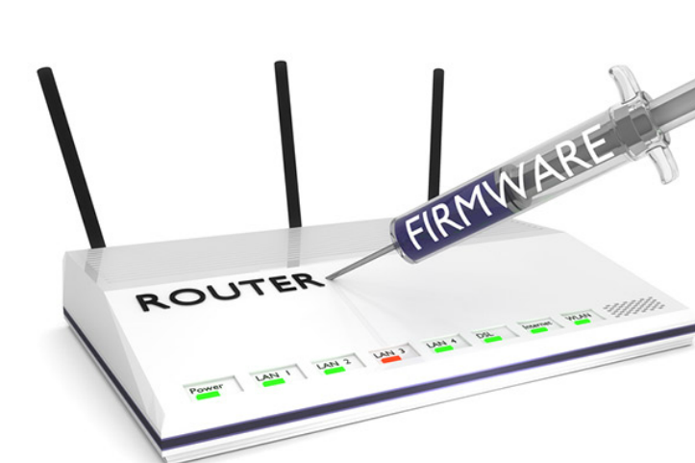
The Cisco IoT System IoT Security
Control Plane, Data Plane, Management Plane
Control plane is the brains of the device, used to make forwarding decisions.
Data plane is activities done to receive data from other devices and to forward them to the next device
Management Plane allows connection to modify a configuration or update software running on a device.
Securing the Control, Data, and Management Planes in IoT
Securing the data plane relates to secure data as it crosses network devices.
Securing the control plane relates to securing the network device itself with tools such as passwords and data encryption.
Securing the management plane is secured by updating software and firmware with the latest patches.
Notes:
5.1 – The Cisco IoT System
5.1.2 – IoT Security

Slide 10

The Cisco IoT System IoT Security (Cont.)
Securing the Control, Data, and Management Planes in IoT (cont’d)
A few recommendations:
Make sure the new IoT device can be easily updated.
Buy from a reputable manufacturer.
Segment IoT devices to a different network or VLAN.
Check for updates regularly.
Default usernames/passwords must be changed
Limit management access od devices to trusted sources
Turn off all unnecessary services
Securing Things Using the Cisco IoT System
The IoT introduces new attack vectors.
Cisco IoT System security pillar offers scalable cybersecurity solutions.
These cybersecurity solutions include:
Operational Technology (OT) Security, IoT Network Security, IoT Physical Security
Notes:
5.1 – The Cisco IoT System
5.1.2 – IoT Security (Cont.)

Slide 11
5.2 Industrial IoT Applications
Notes:
Cisco Networking Academy Program
Connecting Things
Chapter 5: Connecting the Unconnected

Slide 12
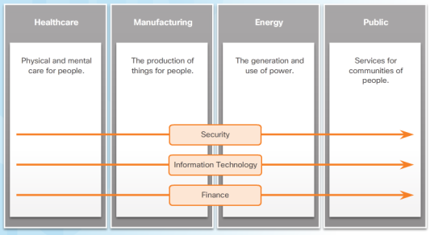
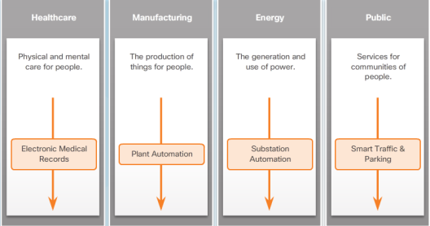
Industrial IoT Applications IoT Industries and Markets
Horizontal Markets
Meet common or similar needs for a wide range of industries.
Security, information technology, and finance companies are examples of industries that operate in horizontal markets..
Vertical Markets
Offer goods and services to a set of customers with specialized needs.
Automotive, banking, education, healthcare, retail, and technology are considered vertical markets.
Notes:
5.2 – Industrial IoT Applications
5.2.1 – IoT Industries and Markets

Slide 13
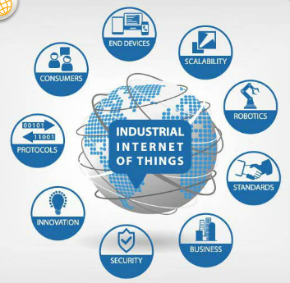
Industrial IoT Applications IoT Industries and Markets
Integrated Solutions
The IoT creates new opportunities for the interaction and relationship between a variety of connected devices.
The IoT is about the integration of devices as a whole system, a holistic approach.
The integration of devices and systems creates new business opportunities and customer experiences.
The Industrial Internet
Integration of complex machinery, sensors and software.
Example: driverless car uses data from different systems to be driven safely
Most common application is predictive maintenance.
Sensors is trains, planes, and large equipment keep track of hours of operation, machine output, environmental factors and determine when it needs maintenance.
Notes:
5.2 – Industrial IoT Applications
5.2.1 – IoT Industries and Markets

Slide 14
5.3 IoT Systems in the Real World
Notes:
Cisco Networking Academy Program
Connecting Things
Chapter 5: Connecting the Unconnected

Slide 15
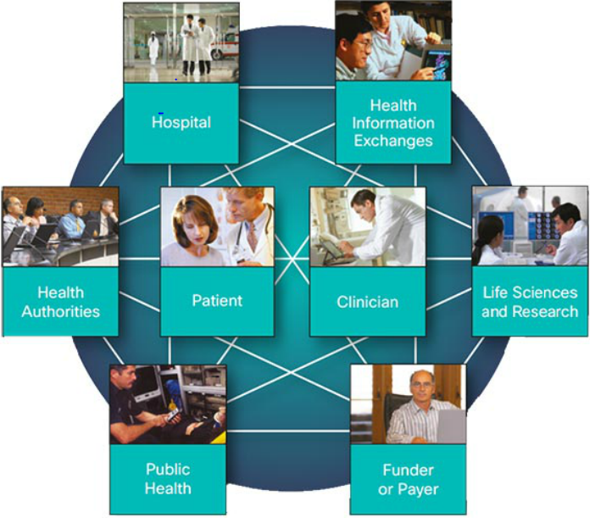
IoT Systems in the Real World Connected Healthcare
Challenges in Healthcare
Increasingly aging population.
High-demand services.
Shortages in key medical specialties.
Rising healthcare costs.
Cisco Care-At-A-Distance Solutions
Care-at-a-distance value propositions:
Cisco Extended Care
Cisco TelePresence for Healthcare
Cisco WebEx for Healthcare
Notes:
5.3 – IoT Systems in the Real World
5.3.1 – Connected Healthcare

Slide 16
IoT Systems in the Real World Connected Healthcare (Cont.)
Cisco Clinical Workflow Solutions
Cisco Virtual Patient Observation
Cisco Patient Connect
Cisco Healthcare Intelligent Contact Center
Cisco Context-Aware (Location-Aware) Healthcare
Digital Media Suite for Healthcare
Cisco Healthcare Management Solutions
Cisco also provides healthcare provider management solutions:
Cisco Services for Connected Health
Cisco Medical-Grade Network
Notes:
5.3 – IoT Systems in the Real World
5.3.1 – Connected Healthcare

Slide 17

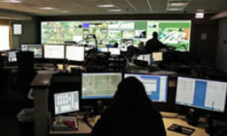

IoT Systems in the Real World Smart Cities
Challenges Faced By Modern Cities
Overcrowding
Increasing pollution
Increasing traffic congestion
Inadequate parking
Inefficient use of street lighting, water, and waste management
Need for continued growth
Pressure to provide safer and more secure cities
Budget and resource constraints
Cisco Smart+Connected Solutions
Customer segments of a city include its citizens, visitors, industry partners, businesses, and municipal operations.
Smart cities must address the needs of these segments.
Smart City Value Propositions:
Lighting, Operations Centers, Parking, Safety and Security, Traffic, Wi-Fi.
Notes:
5.3 – IoT Systems in the Real World
5.3.2 – Smart Cities

Slide 18
IoT Systems in the Real World Smart Cities (Cont.)
Smart City - Hamburg, Germany
The city of Hamburg, Germany has transformed itself into a smart city. [VIDEO]
Cisco Smart+Connected Wi-Fi
Connects people, data, devices, processes, and city services.
Value propositions provided by the Cisco Smart+Connected Wi-Fi to customer segments include:
Citizen Services, City Services, Business Services, City commerce, Infrastructure Management Services.
Notes:
5.3 – IoT Systems in the Real World
5.3.2 – Smart Cities

Slide 19
IoT Systems in the Real World Smart Cities (Cont.)
Cisco Smart+Connected Lighting
A standards-based system for gathering a wide variety of data from the environment.
Collects levels for humidity, CO2 and O2, UVA and UVB light, particulate matter, motion and seismic activity, video, sound, and more.
Drastically reduce city energy consumption.
Improve citizen vehicle compliance.
Enhance situational awareness, real-time collaboration, and decision making across city agencies
Add intelligent, sensor-based IoT innovations to transportation, utilities, public safety, and environmental monitoring.
Cisco Smart+Connected Parking and Traffic
Smart cities can simplify parking and improve traffic flow.
The Cisco Smart+Connected Parking solution provides citizens with real-time information about available parking.
Also allows them to book spaces in advance using mobile applications.
Notes:
5.3 – IoT Systems in the Real World
5.3.2 – Smart Cities

Slide 20
IoT Systems in the Real World Smart Cities (Cont.)
Cisco Smart+Connected Operations Center
Cities are increasingly looking for a customized, integrated, single-interface view of this data.
The Cisco Smart+Connected Operations Center solution displays sensor, map, and video data across a single layout.
It allows operators to control dynamic activities involving image processing, video feeds, data integration, and alerts.
Notes:
5.3 – IoT Systems in the Real World
5.3.2 – Smart Cities

Slide 21

IoT Systems in the Real World Smart Grids
Challenges in Energy
Rapid increase in consumption is putting a strain on energy providers in many countries.
There is also an increasing pressure to use low-carbon energy sources instead of fossil fuels.
Different ways of thinking about power and the way that it is consumed are needed.
IoT Solutions for the Power Grid
Utilities need a more modern and agile electric grid.
Smart grid provides more complex interconnections between the producers, storage facilities, and consumers of electricity.
Smart grid brings the notion of the consumers generating power for themselves and to the grid.
Notes:
5.3 – IoT Systems in the Real World
5.3.2 – Smart Grids

Slide 22
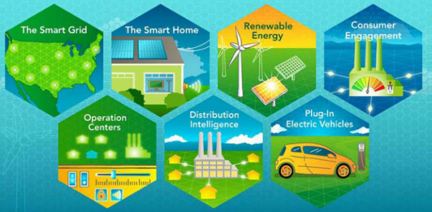
IoT Systems in the Real World Smart Grids (Cont.)
Cisco Smart Grid Solutions
Cisco provides many smart grid solutions including:
GridBlocks Architecture
Connected Grid Services
Field Area Network
Transmission and Substation
Grid Security
Grid Operations
Notes:
5.3 – IoT Systems in the Real World
5.3.2 – Smart Grids

Slide 23
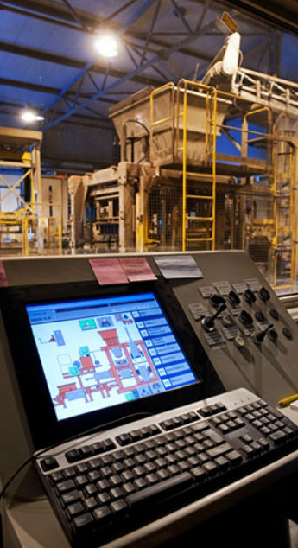
IoT Systems in the Real World Connected Manufacturing
Challenges in Manufacturing
Manufacturing must continually integrate new innovative technology into the existing plant infrastructure.
Multiple siloed operational technology networks become a problem.
Diversity in networks increases cost and complexity.
That lack of integration leads to a broad range of issues, including:
Inefficient operations
Slow response times both in the factory and in the market
Poor quality control
High overhead
Compromised security
Notes:
5.3 – IoT Systems in the Real World
5.3.4 – Connected Manufacturing

Slide 24
IoT Systems in the Real World Connected Manufacturing (Cont.)
IoT Solutions for Manufacturing
IoT solutions connect the right people to the right information.
Connected sensors provide a unique level of visibility into the factory operations and supply chain flow.
Collected data contributes to identifying trends and relationships, revealing opportunities for improvement.
For example, car companies now use sensor data to decide if conditions are favorable to paint a car.
Cisco Manufacturing Solutions
Cisco provides the following IoT manufacturing value propositions:
Cisco Connected Factory
Cisco Connected Machines
Cisco Secure Ops
Cisco Connected Supply Chain
Cisco Communications and Collaboration Tools
Notes:
5.3 – IoT Systems in the Real World
5.3.4 – Connected Manufacturing

Slide 25
5.4 Chapter Summary
Notes:
Cisco Networking Academy Program
Connecting Things

Slide 26
Chapter Summary Summary
The Cisco IoT System relies on six pillars: Network Connectivity, Fog Computing, Security, Data Analysis, Management and Automation, and Application Enablement Platform. Security is very important for IoT, because it ensures that the data, control, and management planes are secure.
The IoT spreads across both vertical and horizontal markets. Connected Healthcare, Smart Cities, Smart Grids and Connected Manufacturing are a few examples of real world IoT Systems.
Connected Healthcare uses the IoT to help healthcare providers reduce costs, improve productivity, and deliver better care to people in rural communities as well as in urban centers.
Smart Cities value propositions encompass lighting, operations centers, parking, safety and security, traffic, and Wi-Fi.
Smart grid brings the notion of the consumers generating power for themselves and the grid. Connected
Manufacturing relies on sensors to provide visibility into factory operations and supply chain flow.
Notes:
5.41.1 - Summary

Slide 27


Slide 28


